Slide 1
GitOps
What The Hack
Rishabh Saha – Cloud Solution Architect

Slide 2

Challenge Scenario

Slide 3
Challenge Scenario
3 Business Units
15 Business Segments
400 developers to be onboarded
10 Kubernetes platform developers/Devops engineers to operationalize it

Slide 4
Questions to ask
For an application you are familiar with, write down all the steps needed to implement a new feature, test it, deploy it, and have it become available for use by end-users.
How long does each step typically take?

Slide 5
Bespoke application deployment
Build the container image
Generate and/or modify Kubernetes API resource specifications to use the new image
Reconcile those resources with a Kubernetes cluster

Slide 6
Personas
Application developers
Application operators
Environment developers and Cluster operators

Slide 7
Customer Needs?
Developers and Operators must integrate multiple services
Set up cluster
CI/CD
Hook up monitoring/logging and management
Ability to provide pre-integrated solution in one place
Accelerate getting initial application running
Simplify configuration and management of advanced applications
Notes:
Large enterprises and even smaller customers

Slide 8
Summary
Developer flow
Deploy application to various environments
Environments maybe spread across different accounts, clusters and namespaces with subtle differences
Configuration re-use very important is to achieve the above requirement
Move from a Git commit in their code base to deploying to each of their environments in a fully automated way
Operator flow
Multi-stage deployment pipelines
Deployment environment management
Configuration Management
For third party applications the most important criteria for this user is to easily receive updates from an upstream source and upgrade their application as easily and seamlessly as possible (e.g. new versions, security patches, etc)

Slide 9
Journey to GitOps…
Here’s our roadmap for the hack
Introduction to GitOps on AKS
Understand YAML and Configs
Set up Helm Release
Set up Blue Green Releases
GitOps - Operations by PR
Config Management | Multi-cluster deployments
GitOps for Self Service and Automation
GitOps for Uptime and Reliability
Set up Canary releases

Slide 10
Challenge 0
Ready, Set, GO!!! Get your machine ready!
SETUP ALL THE REQUIRED TOOLS & PERMISSIONS
Install AZ CLI
INSTALL KUBECTL
INSTALL HELM V3
INSTALL FLUXCTL
Install kustomize

Slide 11
Challenge 0-Arc
Ready, Set, GO!!! Get your machine ready!
SETUP ALL THE REQUIRED TOOLS & PERMISSIONS
Install AZ CLI
INSTALL KUBECTL
INSTALL HELM V3
INSTALL Arc for aks
Install kustomize

Slide 12
Introducing GitOps What’s all the hype?!

Slide 13
What is GitOps
GitOps is a way of implementing Continuous Deployment for cloud native applications.
It focuses on a developer-centric experience when operating infrastructure, by using tools developers are already familiar with, including Git and Continuous Deployment tools.

Slide 14
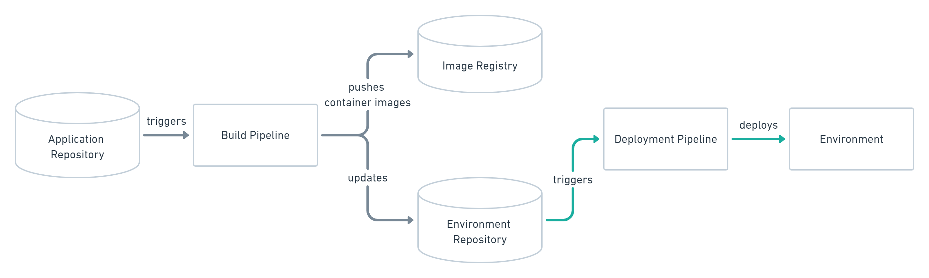
Push-based deployments
Notes:
The Push-based deployment strategy is implemented by popular CI/CD tools such as Jenkins, CircleCI, or Travis CI. The source code of the application lives inside the application repository along with the Kubernetes YAMLs needed to deploy the app. Whenever the application code is updated, the build pipeline is triggered, which builds the container images and finally the environment configuration repository is updated with new deployment descriptors.
Tip: You can also just store templates of the YAMLs in the application repository. When a new version is built, the template can be used to generate the YAML in the environment configuration repository.
Changes to the environment configuration repository trigger the deployment pipeline. This pipeline is responsible for applying all manifests in the environment configuration repository to the infrastructure. With this approach it is indispensable to provide credentials to the deployment environment. So the pipeline has god-mode enabled. In some use cases a Push-based deployment is inevitable when running an automated provisioning of cloud infrastructure. In such cases it is strongly recommended to utilize the fine-granular configurable authorization system of the cloud provider for more restrictive deployment permissions.
Another important thing to keep in mind when using this approach is that the deployment pipeline only is triggered when the environment repository changes. It can not automatically notice any deviations of the environment and its desired state. This means, it needs some way of monitoring in place, so that one can intervene if the environment doesn’t match what is described in the environment repository.

Slide 15
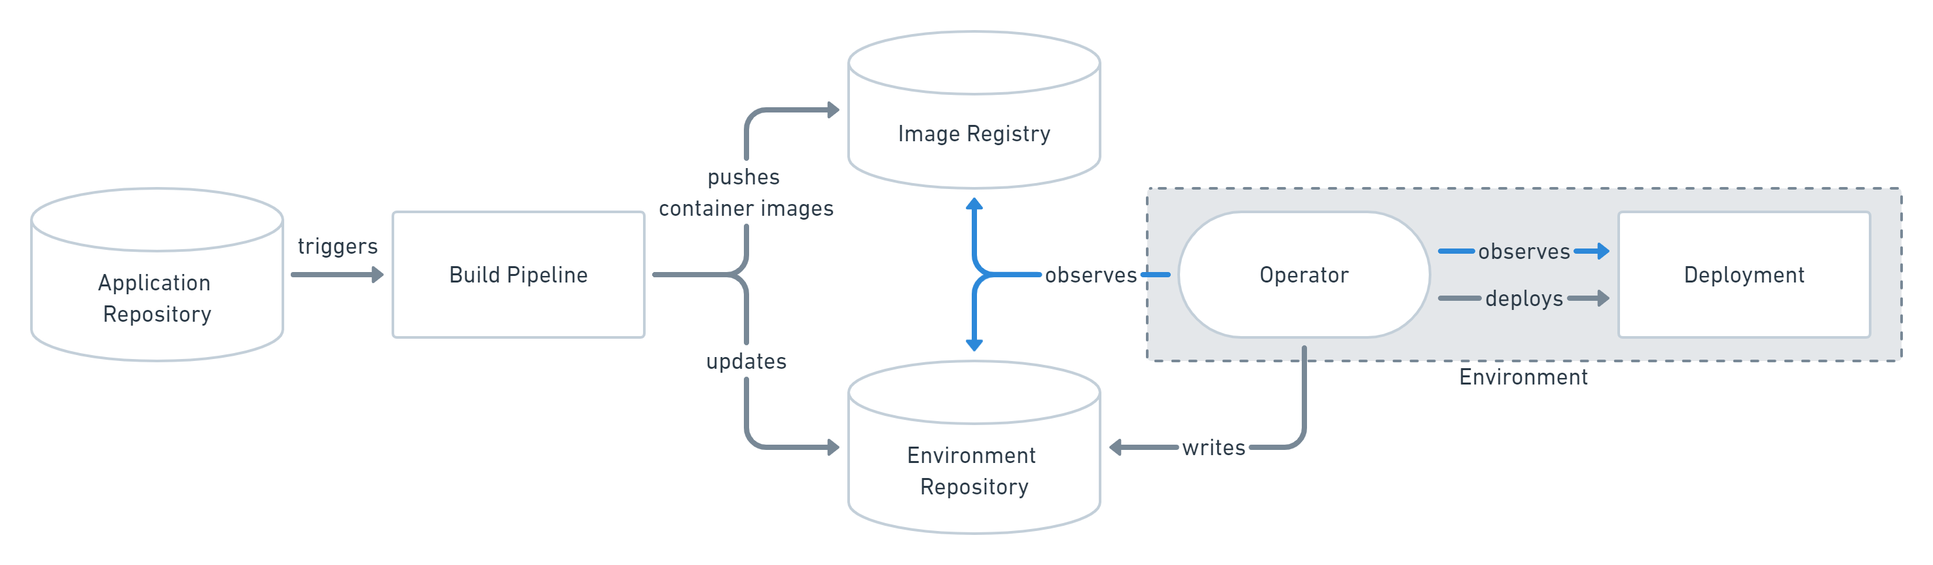
Pull-based deployments

Slide 16
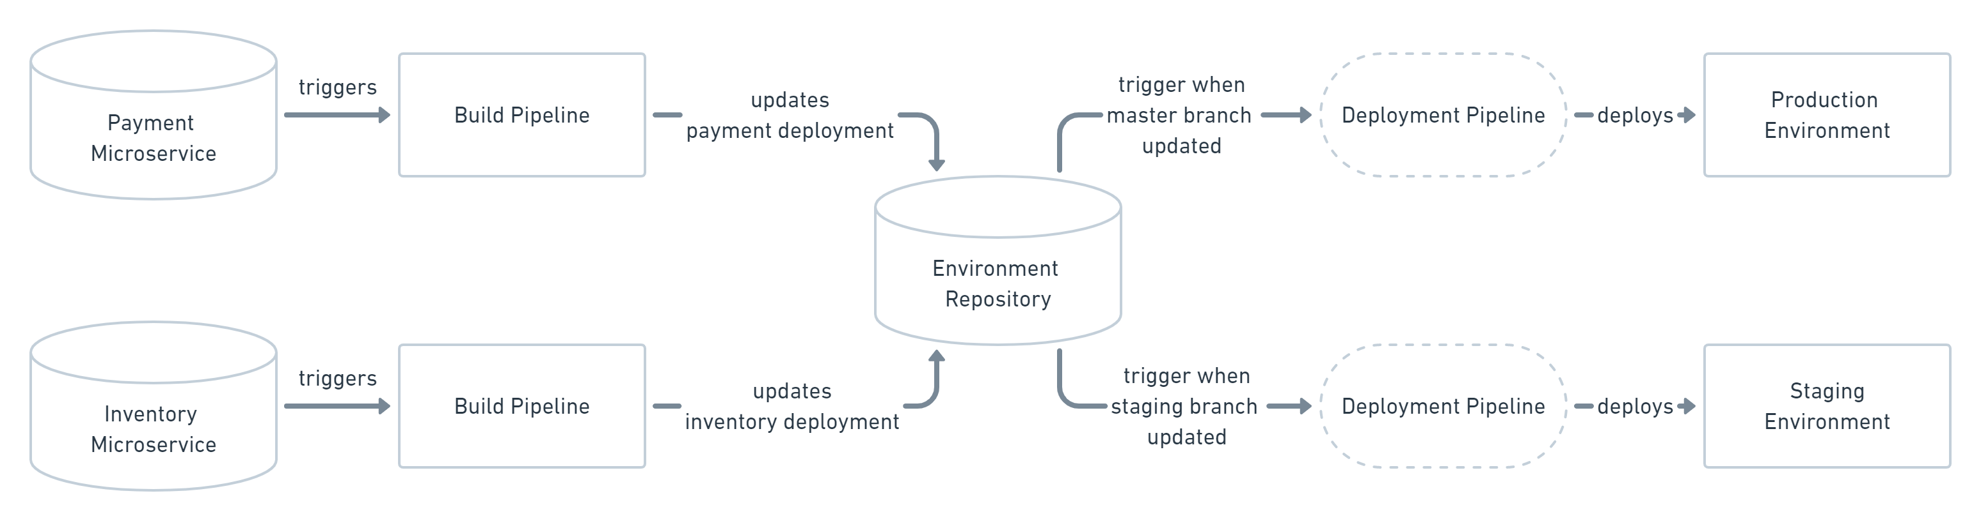
Working with Multiple Applications and Environments

Slide 17
Challenge 1
Set up GitOps on AKS
Create an AKS cluster
GitOps enable your cluster
Set up your Git repository
Enable your cluster for GitOps
Flux and GitOps

Slide 18
Challenge 1-Arc
Set up GitOps on AKS
Create an AKS cluster
GitOps enable your cluster
Set up your Git repository
Enable your cluster for GitOps
Azure Arc and GitOps
Notes:
azure-arc-kubernetes-preview/use-gitops-in-aks-cluster.md at master · Azure/azure-arc-kubernetes-preview (github.com)
az aks enable-addons -a gitops -n <AKSClusterName> -g <AKSResourceGroup>
az k8sconfiguration create --name cluster-config --cluster-name ${CLUSTER_NAME} --resource-group ${RESOURCE_GROUP} --operator-instance-name cluster-config --operator-namespace cluster-config --repository-url git://github.com/Azure/arc-k8s-demo.git --scope cluster --cluster-type managedclusters
az k8sconfiguration show -n cluster-config -c aks-gitops-wth --cluster-type managedClusters -g rg-aks-gitops

Slide 19
Challenge 2
Understand YAML and Configs
Deploy Application using kubectl
Setup Kubernetes label
K8 YAML Structure
Deployment Manifest
Service Manifest
Notes:
azure-voting-app-redis/azure-vote-all-in-one-redis.yaml at master · Azure-Samples/azure-voting-app-redis (github.com)

Slide 20
GitOps

Slide 21
Challenge 3
Deploy apps in challenge 2 using GitOps
Show removal dependency from kubectl

Slide 22
Challenge 4
Deploy application using Helm CLI manually*

Slide 23
Challenge 5
Setup HelmRelease Operator
Install the Helm Release Flux CRD
Distinguish between standard helm deployments and HelmRelease
<Insert need for HelmReleases | Drawback of helm deployments>

Slide 24
Challenge 5
Setup HelmRelease Operator - Arc
Update Arc to install the Helm Release operator
Distinguish between standard helm deployments and HelmRelease
<Insert need for HelmReleases | Drawback of helm deployments>
Notes:
az k8sconfiguration create --name azure-arc-sample --cluster-name AzureArcTest1 --resource-group AzureArcTest --operator-instance-name flux --operator-namespace arc-k8s-demo --operator-params='--git-readonly --git-path=releases' --enable-helm-operator --helm-operator-version='0.6.0' --helm-operator-params='--set helm.versions=v3' --repository-url https://github.com/Azure/arc-helm-demo.git --scope namespace --cluster-type connectedClusters
Azure/arc-helm-demo: Repo For Arc For Kubernetes Helm Demo (github.com)
Deploy Helm Charts using GitOps on Arc enabled Kubernetes cluster(Preview) - Azure Arc | Microsoft Docs

Slide 25
Challenge 6
Install application using Helm Operator (GitOps)

Slide 26
Challenge 6
Show Rolling Updates
Move to Blue Green deployments
Remove dependency from kubectl

Slide 27
Challenge 7
GitOps – Operations by PR
PR for Ops (Think about multi-tenancy)
Audit Trails
GRC (Governance | Risk | Compliance)

Slide 28
GitOps <Subtopic>

Slide 29
Challenge 8
Config Management
Config Management
Promotion between Environments
Multi-tenant cluster | Cluster with multiple environments

Slide 30
Challenge 9
GitOps for Self Service and Automation!
(Success Criteria)
Identify success criteria for all challenges
Identify artifacts
Azure cat/dogs/redis

Slide 31
Challenge 10
GitOps for Uptime and Reliability (Multi-cluster deployments*)

Slide 32
Challenge 11
Setup Canary Releases

Slide 33
DevOps with K8S Helm

Slide 34

How to Make Meatballs with Kubernetes

Slide 35



Hard Way – With YAML Files + kubectl

Slide 36


Easy Way – with Helm Charts

Slide 37

Helm
Azure Kubernetes Service (AKS)
The best way to find, share, and use software built for Kubernetes
Azure Container Instances (ACI)
Azure Container Registry
Manage complexity
Charts can describe complex apps; provide repeatable app installs, and serve as a single point of authority
Easy updates
Take the pain out of updates with in-place upgrades and custom hooks
Simple sharing
Charts are easy to version, share, and host on public or private servers
Rollbacks
Use helm rollout to roll back to an older version of a release with ease
Open Service Broker API (OSBA)
Release Automation Tools

Slide 38

Helm
Azure Kubernetes Service (AKS)
Helm Charts helps you define, install, and upgrade even the most complex Kubernetes application
Azure Container Instances (ACI)
services
ci
db
Azure Container Registry
load balancer
custom
…
Chart.yml
Open Service Broker API (OSBA)
Release Automation Tools

Slide 39
Helm Charts
Application definition
Consists of:
Metadata
Kubernetes resource definitions
Configuration
Documentation
Stored in chart repository
Any HTTP server that can house YAML/tar files (Azure, GitHub pages, etc.)
Public repo with community supported charts (eg – Jenkins, Mongo, etc.)
Helm (CLI) + Tiller (sever side)
Release: Instance of chart + values -> Kubernetes

Slide 40
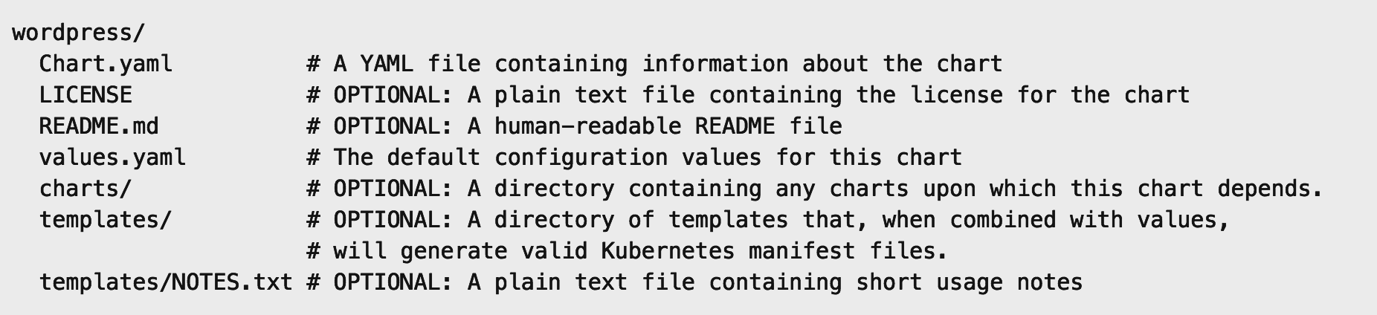
Chart structure
Layout
Helm expects a strict chart structure

Slide 41
Helm values.yaml
The knobs and dials:
A values.yaml file provided with the chart that contains default values
Use -f to provide your own values overrides
Use --set to override individual values

Slide 42
Challenge 9a
Meatballs the hard way
Deploy the specified app using the individual yaml files provided
Deploy the specified app for this challenge using the steps and yaml files provided.
Verify that the app has been deployed successfully.

Slide 43
Challenge 9b
Meatballs the easy way with Helm (local)
Using the Helm Charts from a Local Package
Convert these yaml files that were just used to deploy the app into a Helm chart
Create a package and make it available in the local repository.
Remove the previously deployed app and deploy the helm chart you just created
Verify that the app has been deployed successfully
Make a note of the difference in number of steps involved in the deployment using individual yaml files and the Helm chart

Slide 44
Challenge 9c
Meatballs the easy way with Helm (remote w/ACR)
Using Helm chart from remote repo in Azure Container Registry
Push the Helm chart you just packaged to the remote ACR repo
Remove the package locally
Uninstall the app and redeploy it using the Helm chart from the ACR repo
Verify that the app has been deployed successfully

